Slide 1

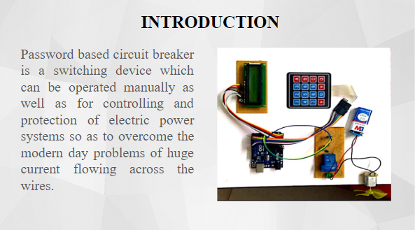
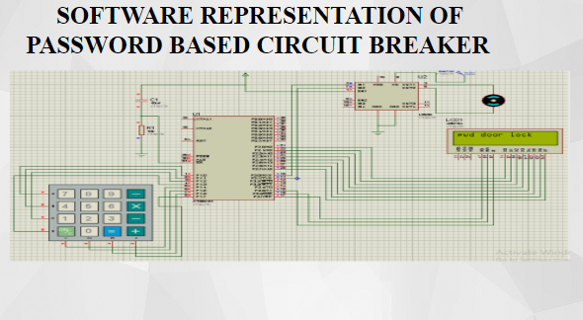
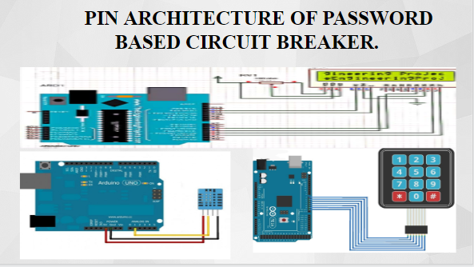
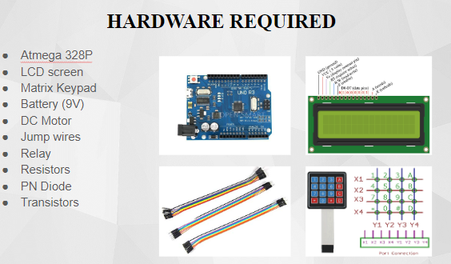
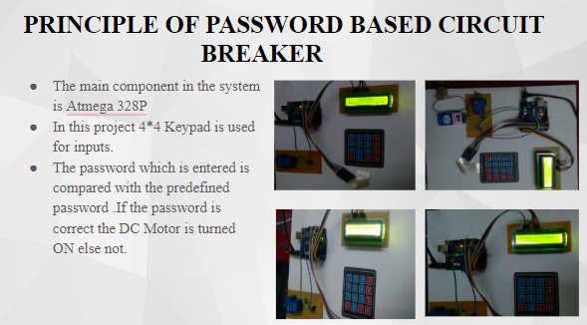
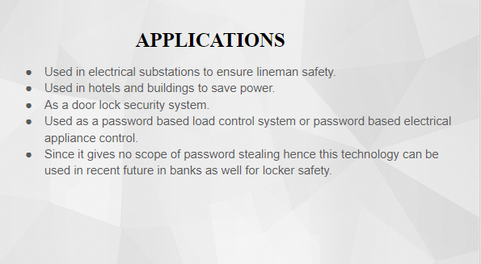
PASSWORD BASED CIRCUIT BREAKER
B.TECH PROJECT EXPO-2019
AMAN SHRIVASTAVA , NIRUPAMA SINHA,PRANSHUL GUPTA,SHREYA SINGH
ELECTRONICS AND TELE-COMMUNICATION ENGINEERING
SCHOOL OF ELECTRONICS ENGINEERING
KALINGA INSTITUTE OF INDUSTRIAL TECHNOLOGY (DEEMED TO BE UNIVERSITY)
SUPERVISED BY: PROF. TIRTHA MAJUMDER

